Slide 1
InternFSU Final Project
Genevieve Ferguson
Computational Science Major
The Innovation Hub
Supervised by Ken Baldauf
Workshops at The Hub

Slide 2
A: My project helped students learn and cultivate useful skills such as coding with Python and how to 3D print.
Q: How does your project benefit FSU students, staff/faculty and the community?

Slide 3
A: I have learned valuable public-speaking and leadership skills from my time at The Hub. Therefore, moving forward, I will be able to communicate well at my job and advocate for myself and others effectively.
Q: How will this experience/internship benefit your future career or post-graduation goal?

Slide 4
Tutorials found at: https://www.innovation.fsu.edu/learn-3d-printing and https://www.innovation.fsu.edu/learn-coding
Work Samples

Slide 5
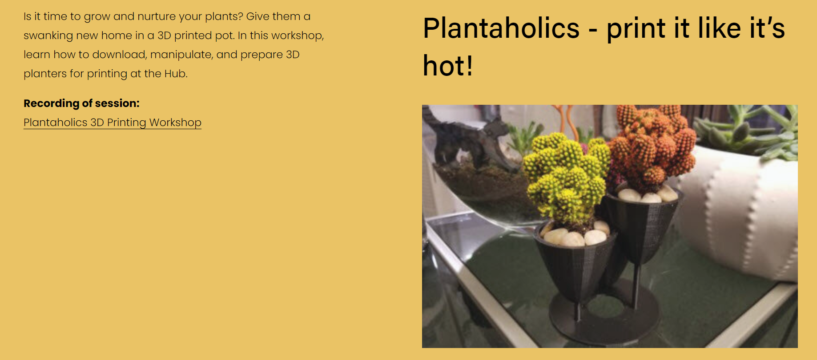
Gardening Themed workshop

Slide 6
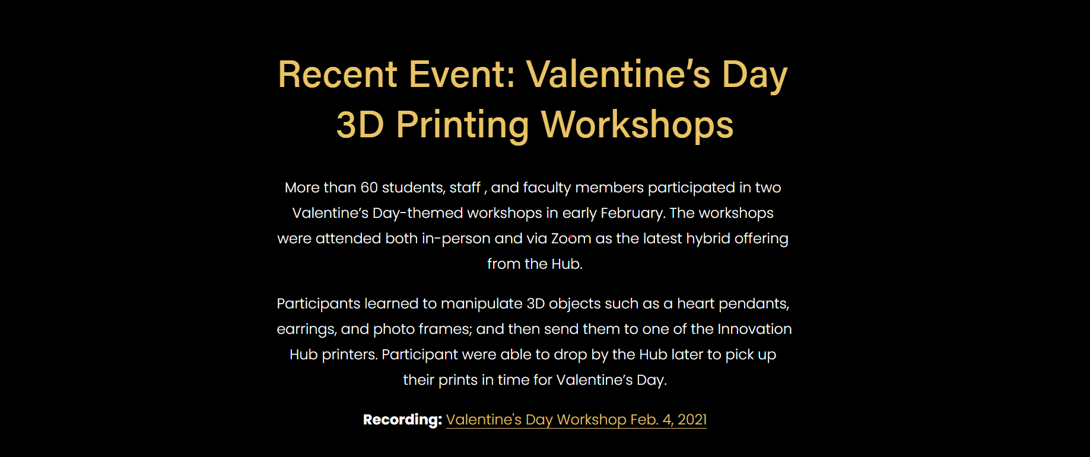
Valentine’s Day Themed workshop

Slide 7
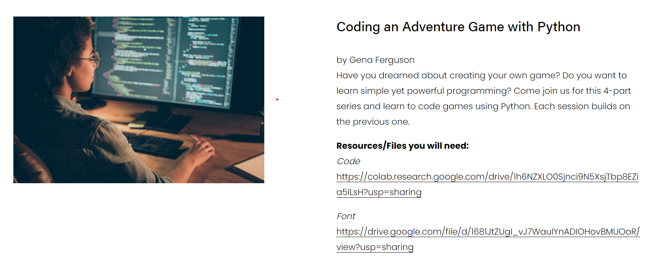
Python workshop

